Slide 1
Quad World
An Inspiration from Mine Craft
Team Members:
Aashish Bhandari (070BEX401)
Aashish Neupane (070BEX402)
Aayush Kafle (070BEX403)

Slide 2
Concepts used in our project
Polygon( Rectangle) Table
Matrix Operation
Camera Orientation and Key handling
Modeling, World and Viewing Coordinates
3D Rotation
Perspective Projection
Back-face detection
Shading and Illumination

Slide 3
Object Table
Vertex Table
Edge Table
Polygon Table
Vertices
Normal
Light Source Vector
Viewing Vector
Color

Slide 4
Matrix operation
Matrix Multiplication
Transformation Matrix
Composite Transformation
Operator Overloading

Slide 5
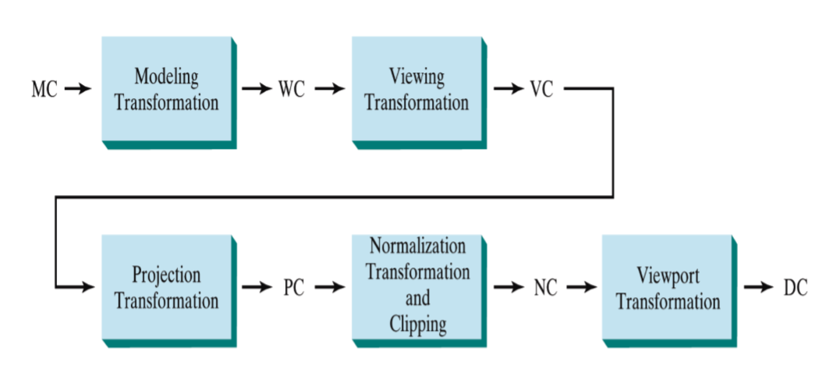
VIEWING PIPELINE

Slide 6
MODELLING, world and viewing COORDINATEs
WHAT IS MODELLING , WORLD AND VIEWINGCOORDINATE SYSTEM??
HOW WE HAVE IMPLEMENTED THOSE!

Slide 7
CAMERA ORIENTATION AND KEY HANDLING
SDL 2 used for windowing and key handling.
Example Code:
SDLK_UP,SDLK_D

Slide 8
3D Rotation
Rotation of the object is obtained as by 4*4 homogeneous transformation matrices.
Parameters to be passed: Angle and axis
Parameters are updated via key handling
Different Transformation Matrices are defined as per different rotation axes (using simple if….else)

Slide 9
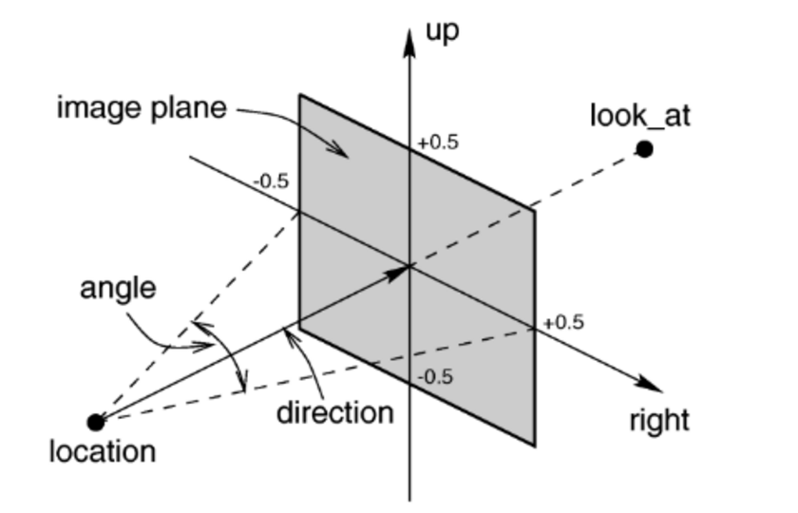
Perspective projection and normalization to the viewport
Transformed points
are projected
onto the viewing plane and then normalized to fit into the viewport.

Slide 10
Used formulae for perspective projection
Using Similar triangle concept
Xp=(Zprp-Zvp)/(Z-Zprp)*X
Yp=(Zprp-Zvp)/(Z-Zprp)*Y
Value of Z from the transformed point.

Slide 11
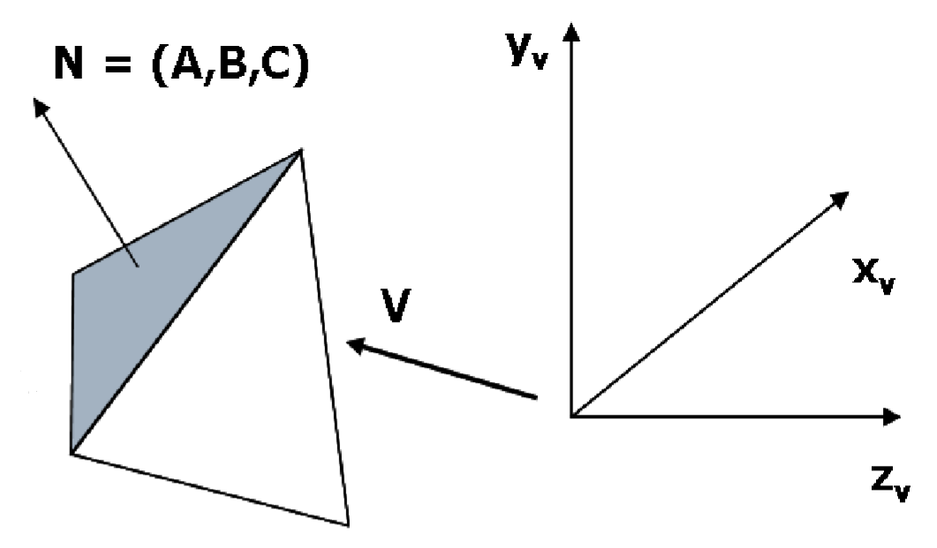
Backface detection
Normal vector and viewing vector calculated
Viewing vector is along (0,0,Vz)
If N.V>=0, the surface is plotted or else not

Slide 12
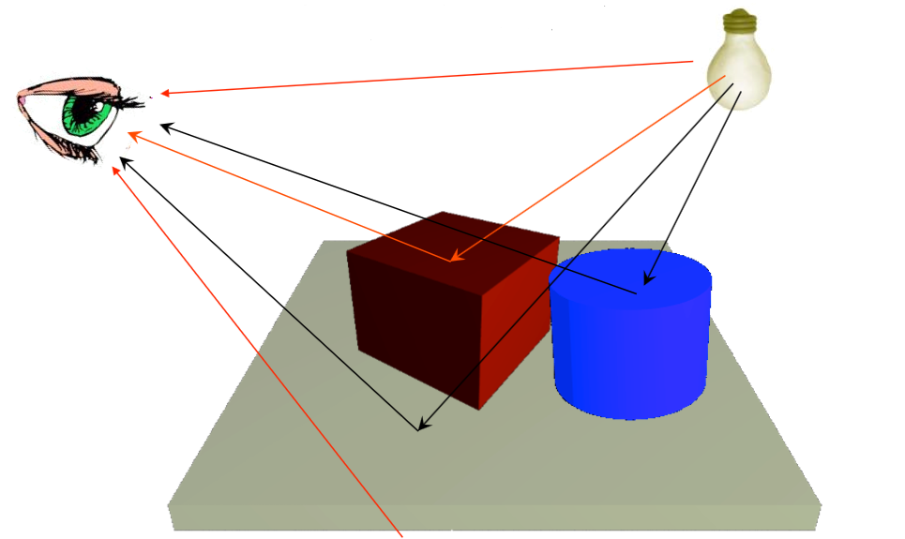
Lighting and illumination
Lighting Models used:
Ambient
Diffuse

Slide 13
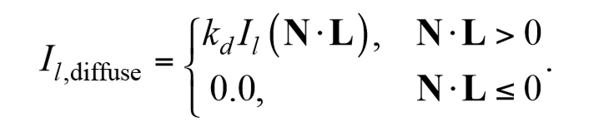
Ambient and diffuse lighting model
Ambient lighting Intensity:
I_{l,a}
Diffuse Lighting Intensity:

Slide 14
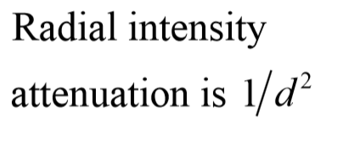
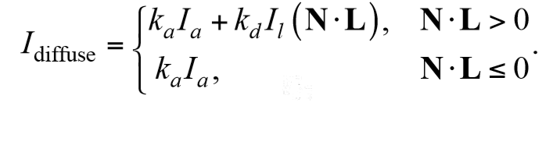
Intensity Attenuation and Overall Intensity

Slide 15
Program DEMO:
Thank You!!

